Slide 1
openSUSE 11.4
Raul Libório (rauhmaru@opensuse.org

Slide 2
Introduction
Introduce Yourself or a bit about yourself

Slide 3
openSUSE for the Universe
openSUSE can be used anywhere and everywhere
  Play games
  Make documents, spreadsheets, presentation on the go
  Watch movies
  Listen and share your favourite songs
  Record your TV shows
  Browse the Internet seamlessly
  And more.......

Slide 4
Choose your look and feel
openSUSE Desktop choices
  GNOME 2.30.1
  KDE SC 4.4.3
  Xfce 4.6.1
  LXDE
With COMPIZ, you can add dazzling effects to your chosen desktop environment.

Slide 5















Surf the Internet
Instant Messaging Clients that can connect to
Check your email via web or local email client
Communicate in real time with
Notes:
mention FireFox, Konquerer, and others not in OSS, like Opera, Chrome, etc.

Slide 6






Be Productive!!
With OpenOffice.org 3.2.1 make documents, spreadsheets and presentations
Manage your finances
Maintain your Journal and plan your daily tasks
Plan your projects
Writer
Impress
Calc
Draw
Base
Notes:
mention the cost savings of open office versus MS Office and yet features are very similar

Slide 7




Multimedia Ready
KDE
  KAFFEINE
  AMAROK
GNOME
  TOTEM
  BANSHEE

Slide 8
Multimedia Ready
With Totem and Kaffeine watch videos, live stream directly from satellite TV and much more
With Banshee and Amarok listen to songs, give your ratings, make your playlists and much more
Sync your multimedia devices
Turn your PC into a home recording environment with Rosegarden 10.04 and LiVES

Slide 9
Games for everyone...
Play loads of games on openSUSE
Play Chess, Sudoku
OpenArena is an FPS game that is based on Quake III
Battle of Wesnoth is a free and popular Strategy game that runs on openSUSE
With WINE you can play games that run on Windows too

Slide 10
Screenshots

Slide 11
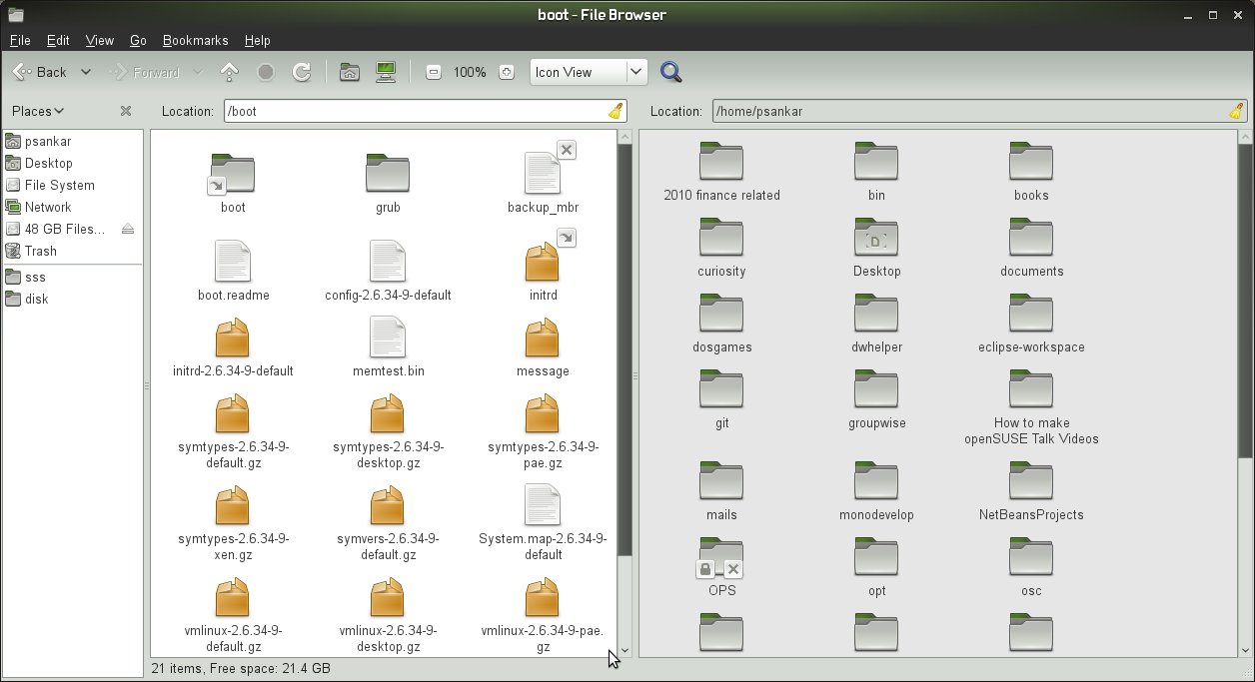

Slide 12
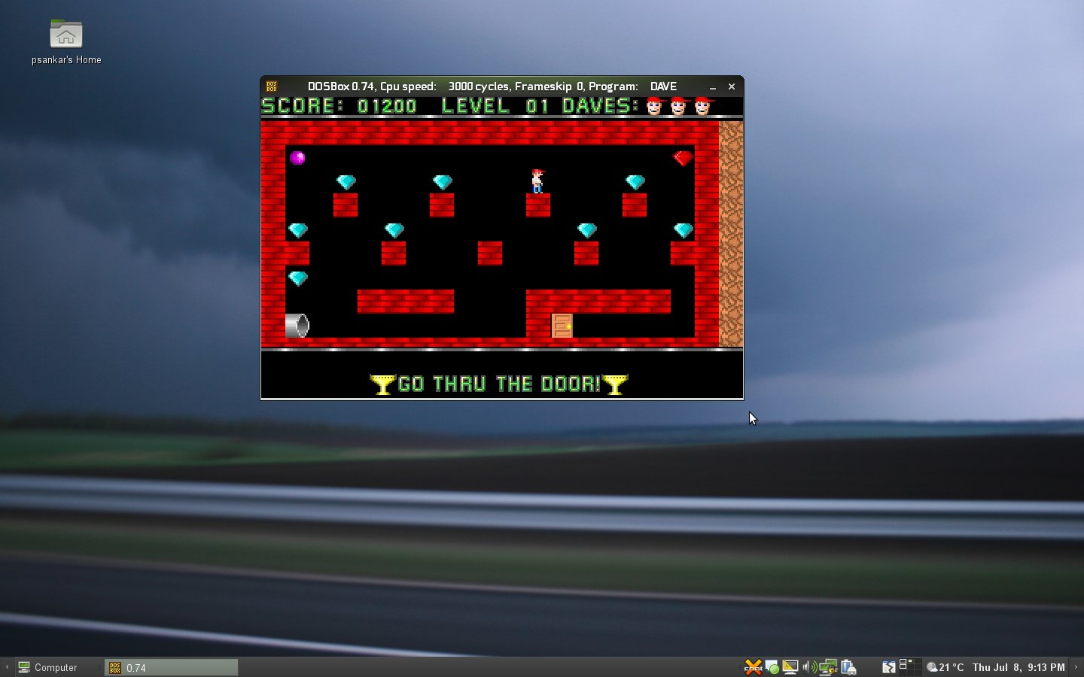

Slide 13
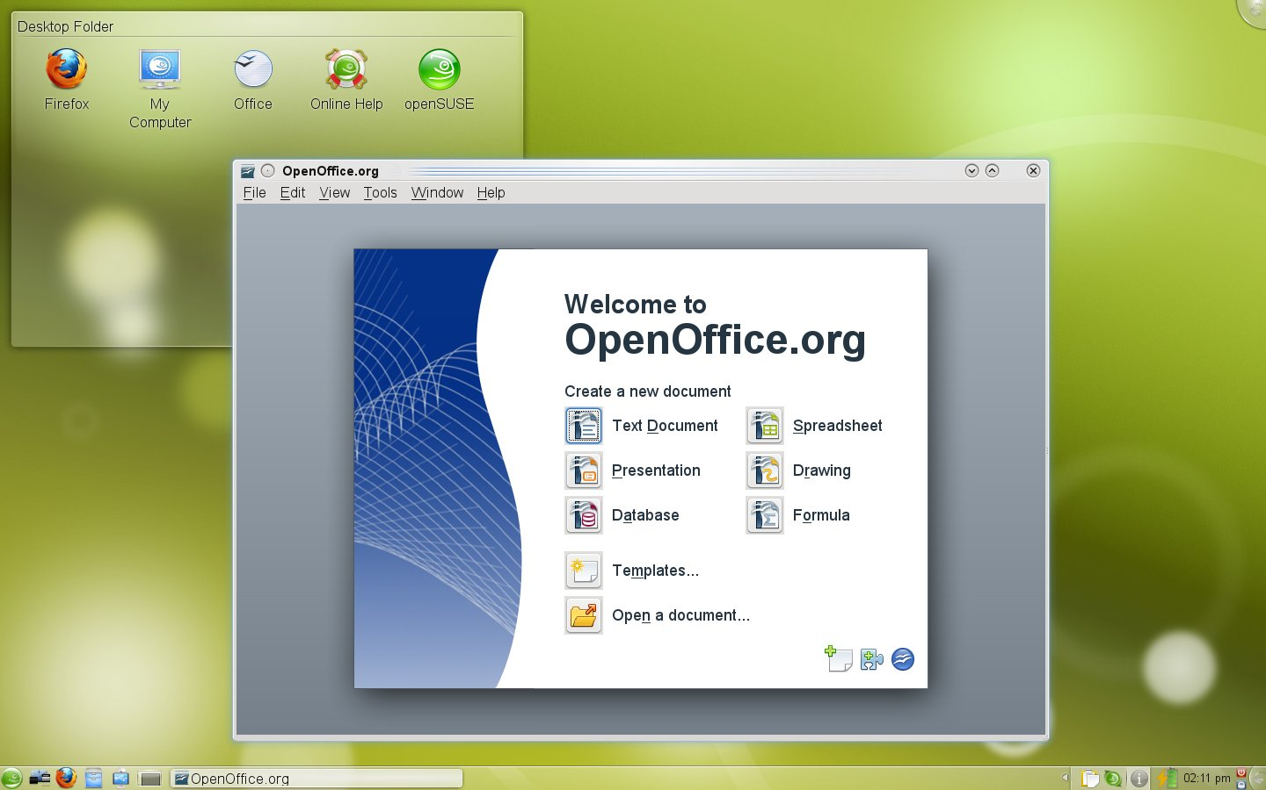

Slide 14
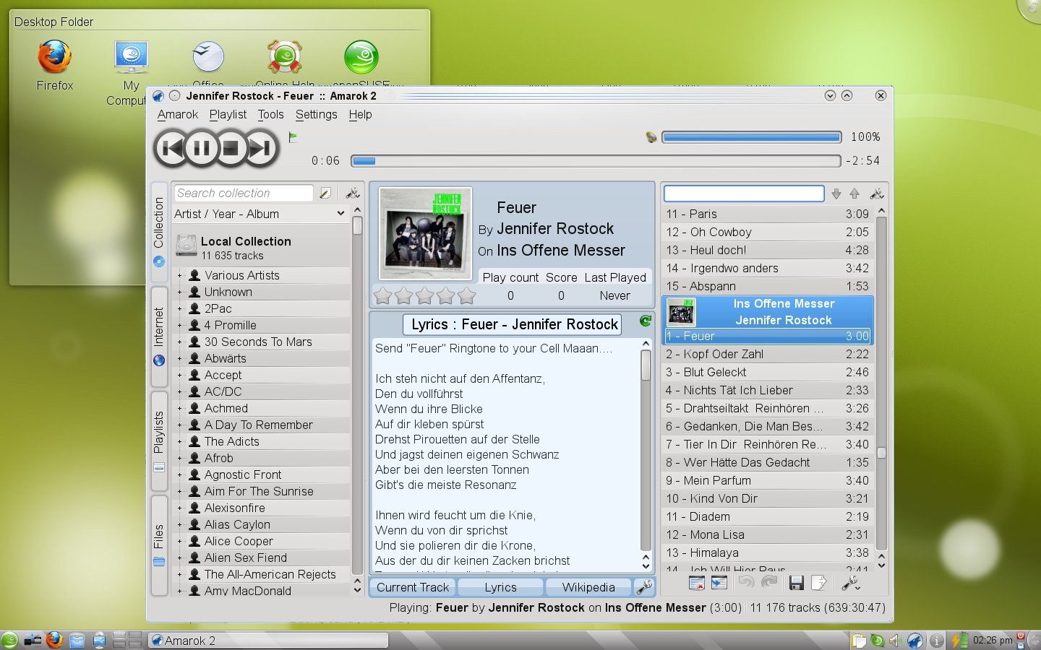

Slide 15
openSUSE Conference 2010
October 20th to 23rd 2010 in Nuernberg, Germany
Call for papers until 31st July
  http://en.opensuse.org/Conference_2010/Call_For_Papers
Details at http://en.opensuse.org/openSUSE:Conference

Slide 16
openSUSE Links
Follow @openSUSE on twitter and identi.ca
Download opensuse via http://software.opensuse.org
Learn more at http://www.opensuse.org

Slide 17
Any Questions???
Testing

Slide 18
Thank you
Testing

